Slide 1
OO Clean code

Slide 2
WRITE CODE FOR THE NEXT PERSON READING IT
“PEMATURE OPTIMIZATION IS THE ROOT OF ALL EVIL”
First write clean and readable code, if the module has an ‘waterfall effect’(might increase in volume(storage,query weight,requests stress) and performance might exponentially decrease), only then you should think of ways to trade readability for optimization – don’t waste time optimizing something that will never need to -> YAGNI

Slide 3
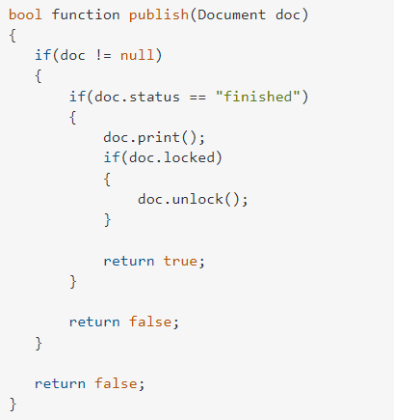
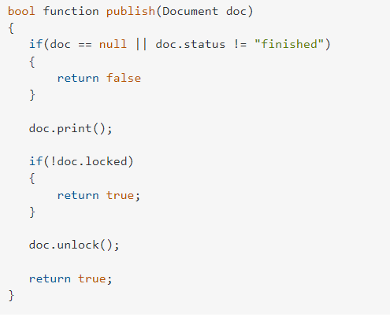
1. Max number of identation: 2
Solution : revert the logic + SRP( if needed )

Slide 4
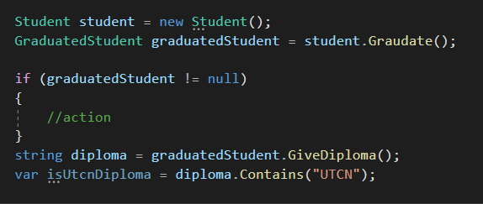
2. One dot per line
Helps debugging , more redabiltiy

Slide 5
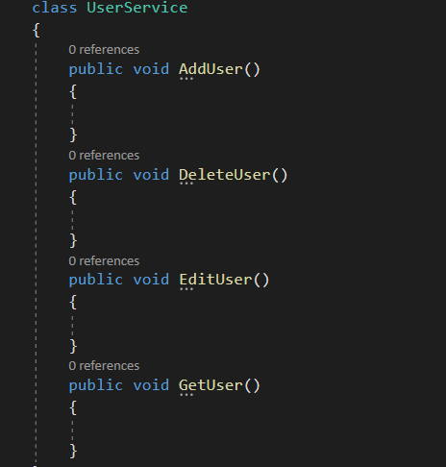
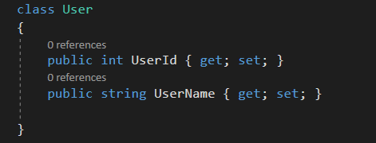
3. Too much info

Slide 6
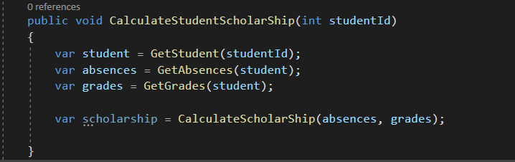
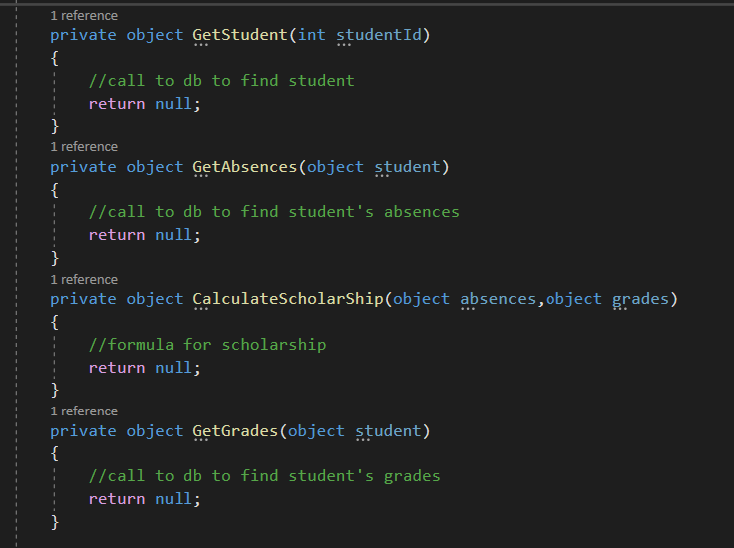
4.Functions as a story/ “TO” paragraphs
A function’s body elements should have the same level of abstractisation.
There’s high level abstraction : function’s body only calls another functions, and low a level abstraction where there is basic code syntax , operations and operators etc.
Translation:
“To” calculate student scholarship I need :
‘to’ get the student
“Then” to get the student I need to call the db
‘to’ get the absences”
“Then” to get the absences I need to call the db
‘to’ get the grades”
“Then” to get the grades I need to call the db
to get the student”
“Then” to get the student I need to call the db

Slide 7
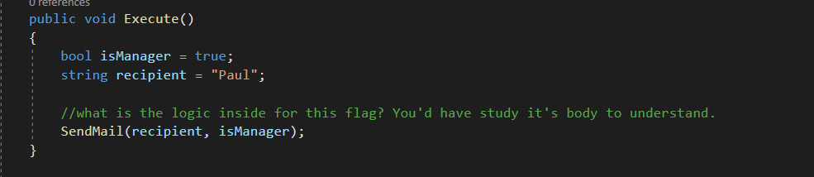
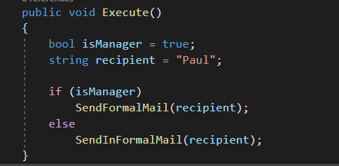
5.Max of 2 arguments, don’t pass booleans
A function should have between 0 and 2 arguments at most, avoid passing Booleans(flags) as parameters because it introduces unknown behavior inside the function.

Slide 8
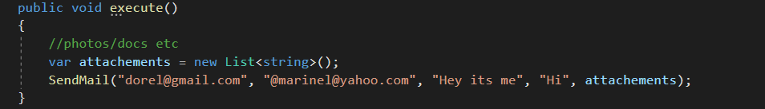
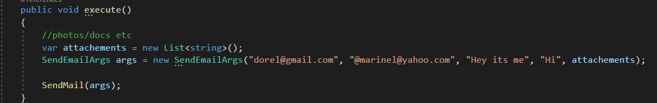
7. Wrap multiple arguments in a class

Slide 9
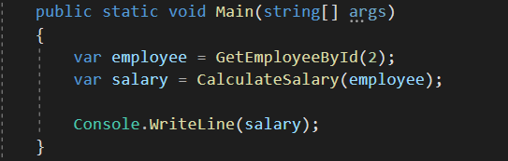
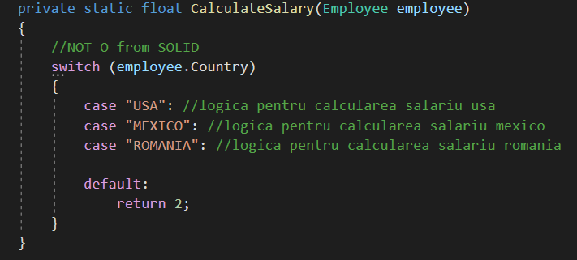
8.Use factory instead of switch - BAD

Slide 10
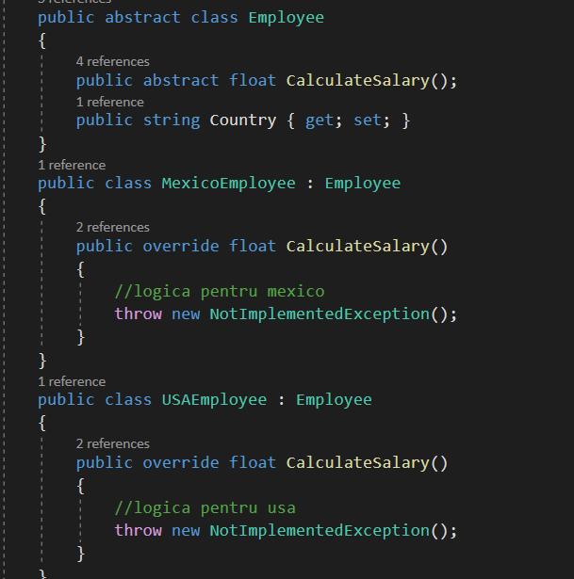
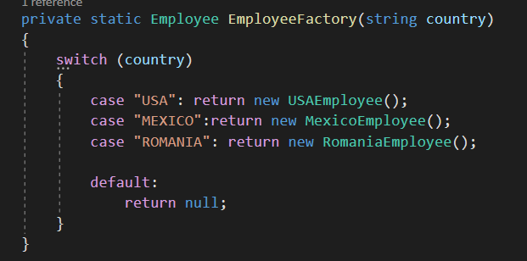
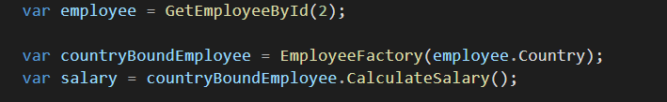
8.Use factory instead of switch – GOOD

Slide 11
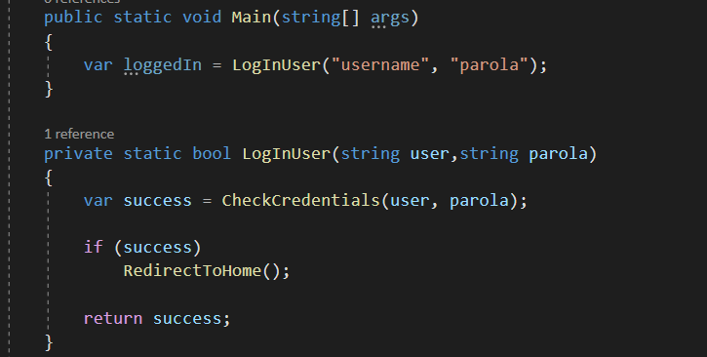
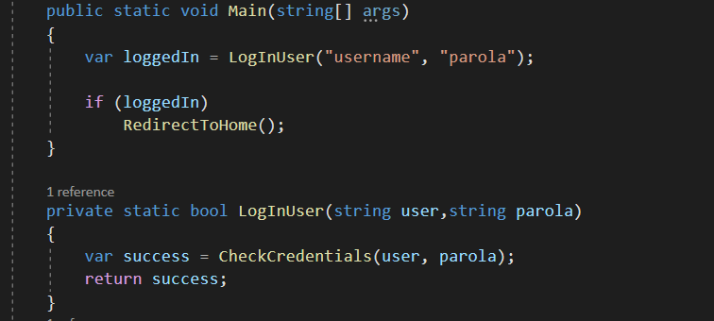
9. Honest functions

Slide 12
10.Avoid out keyword

Slide 13
11. Don’t explain using comments
Daca simti nevoia sa pui comentarii ca sa explici codu, inseamna ca nu e bine scris.
Trebuie sa se inteleaga ce face prin denumire si flow

Slide 14
12.Code as a newspapper
Numele unei clase trebuie sa prezinte ceea ce urmeaza sa se intample in fata(nume clasa ⬄ titlu articol)
Primele functii sa fie generale, sa capteze atentia si sa explice conceptul, apoi pe masura ce coboram sa fie functiile de detalii

Slide 15
13.Abstract FOR inside a function

Slide 16
14. Minimize null presence
Evita returnarea de null, pentru a reduce nr de null checks

Slide 17
15.Keep modules(classes) small - SRP
Daca nu poti numi o clasa in mod concret inseamna ca face mai multe lucruri decat trebuie.
Ex : Generator(generator de ce?) sau Management(ce manageneaza?)
Mai multe clase mici si care respecta SRP e mai bine decat una mare care face prea multe

Slide 18
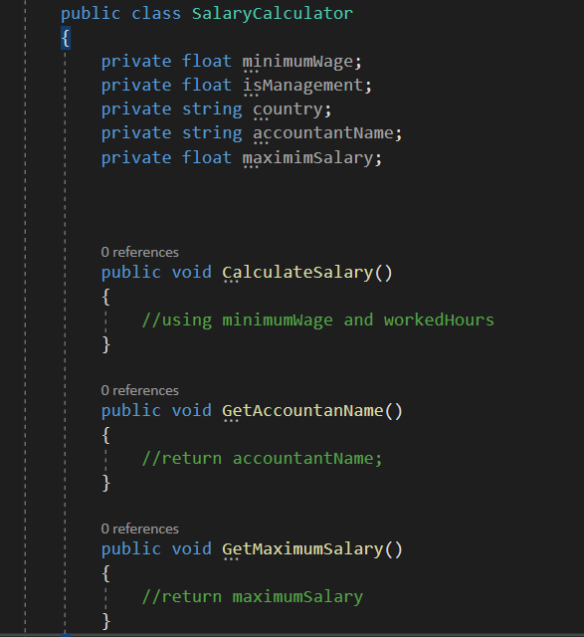
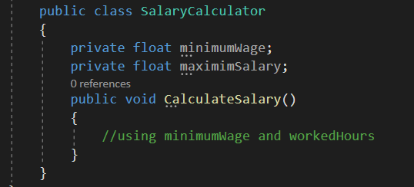
16.High cohesion,low coupling (SRP related)
Low Cohesion example:
High Cohesion example:

